Slide 1
Data Structures
Binary Trees

Slide 2
Topics
Mini Project : Expression Trees
ETNode
How to Construct
Tree Traversal
InOrder
PostOrder
PreOrder
Mini Project: Binary Search Tree
BSTNode
How to Construct
How to Delete
Tree Traversal
Find
FindMax
InOrder

Slide 3
Mini Project : Expression Trees
ETNode
How to Construct
Tree Traversal
InOrder
PostOrder
PreOrder

Slide 4
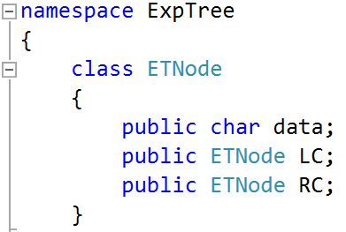
ETNode
data
LC
RC

Slide 5
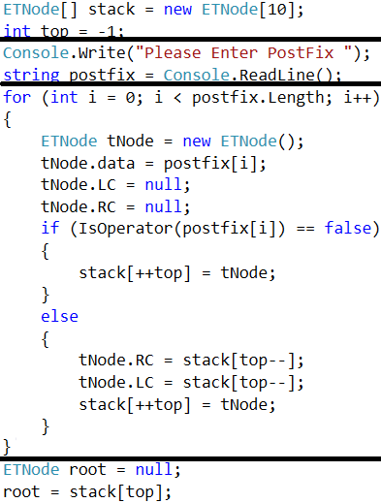
How to Construct Expression Tree

Slide 6
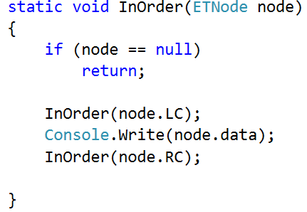

Tree Traversal: InOrder

Slide 7
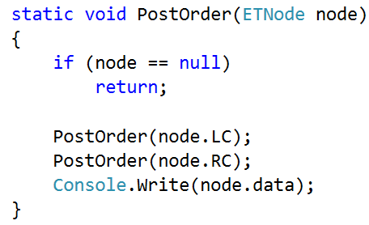

Tree Traversal: PostOrder

Slide 8
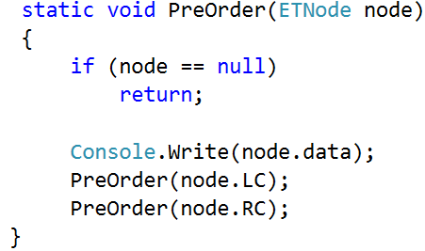

Tree Traversal: PreOrder

Slide 9
Mini Project: Binary Search Tree
BSTNode
How to Construct
How to Delete
Tree Traversal
Find
FindMax
InOrder

Slide 10
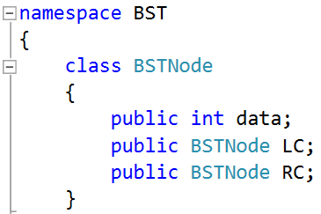
BSTNode
data
LC
RC

Slide 11
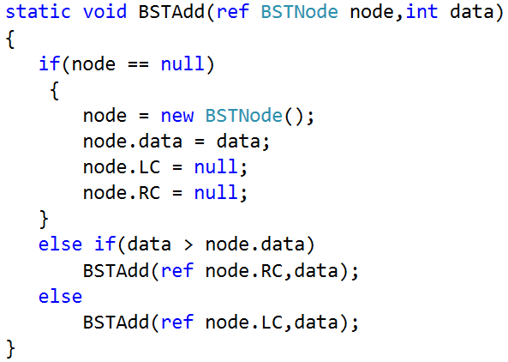
How to Construct BST

Slide 12
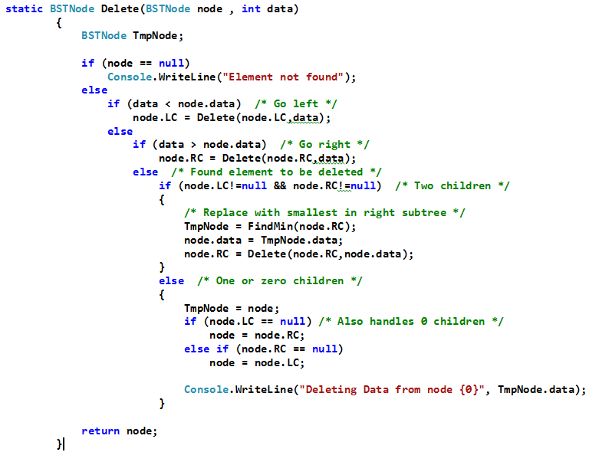
How to Delete Node

Slide 13
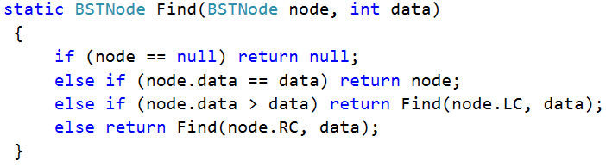
Tree Traversal : Find

Slide 14
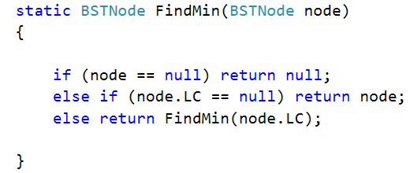
Tree Traversal : Find Min/Max

Slide 15
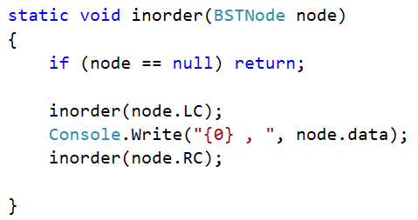
Tree Traversal : Ascending Order

Slide 16
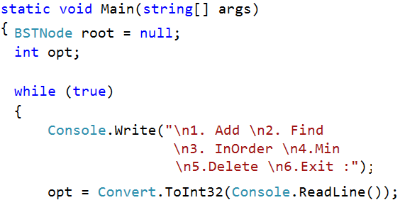
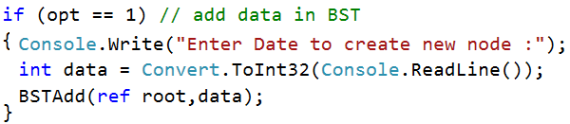
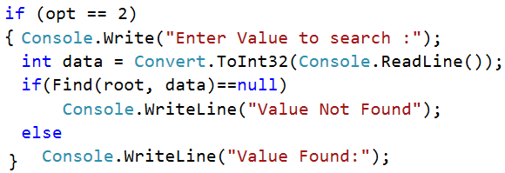
BST : main program

Slide 17
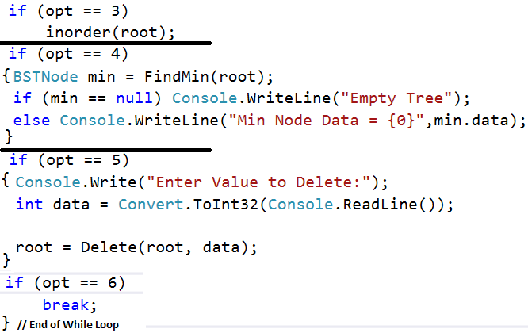
BST : main program

